Slide 1
Insert the sub title of your presentation
Non-Personalised Video Games Recommender
Kenneth Lim / DSI 35

Slide 2
Contents
01.
Background
02.
EDA / Data pre-processing
Recommender Systems overview, Project objectives
Data Analysis, Data transformation
03.
Modelling
04.
Conclusion, Limitations and Future Work
Evaluation and Model Selection

Slide 3
Background

Slide 4

Recommender Systems
Online Information retrieval systems aimed at providing personalised recommendations to users based on preferences or interests
Widely integrated in many applications and platforms to keep users engaged
Aims to provide a concise summary of products for users to choose from
Notes:
info retrieval systems aimed at providing personalised recommendations to users based on preferences or interests. Since the recent decade, it has been widely integrated into our daily lives found in many web applications and platforms in order to keep users and consumers alike engaged. Goal is to provide a detailed summary of business products for users to choose from

Slide 5




Applications of Recommender Systems
Ecommerce
Movie Streaming
Dating Apps
Amazon
Netflix
Tinder
Notes:
Here are some of the common applications of recsys which we probably know of. They are commonly used in many industries such as ecommerce (like Amazon), movie and music streaming services like netflix, spotify, as well as online dating platforms like tinder are running on recsys algorithms.

Slide 6
Consumer Benefits of Recommender Systems
35%
35% of consumer purchases on Amazon
75% of show titles watched on Netflix
Generate new business revenue through personalisation
75%
McKinsey
Notes:
So why do we want to use recsys, and how is it beneficial to us consumers? To justify this point, we are going to refer to this well-known research study conducted by consulting company Mckinsey, which finds that consumers tend to purchase approx 35% of purchases coming from products recommended by recsys, as well as watching approx 75% of show titles provided by them

Slide 7
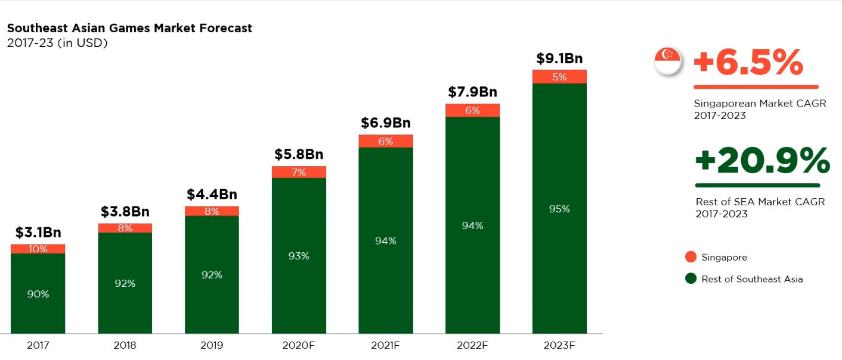
Gaming Industry
Singapore’s Esports sector
1. Rising industry due to huge market growth during Covid-19 pandemic
2. Projected to have an compounded annual revenue growth of about 6.5%
3. Global average weekly playtime on video games: 8-9 hours
Singapore's gaming industry
Techrepublic
Notes:
A little background of our project: In the recent years, SG’s esports scene has been taking and is now a rising industry due to huge market growth experienced during the covid19 pandemic. It is projected to have an annual compounded revenue growth of about 6.5% CAGR. Also, research studies have found on a global level, an average gamer tends to spent about approx 8hours per week on video games.

Slide 8
Objective: Build non-personalised video games recommender
Notes:
Build non-personalised games recommender

Slide 9
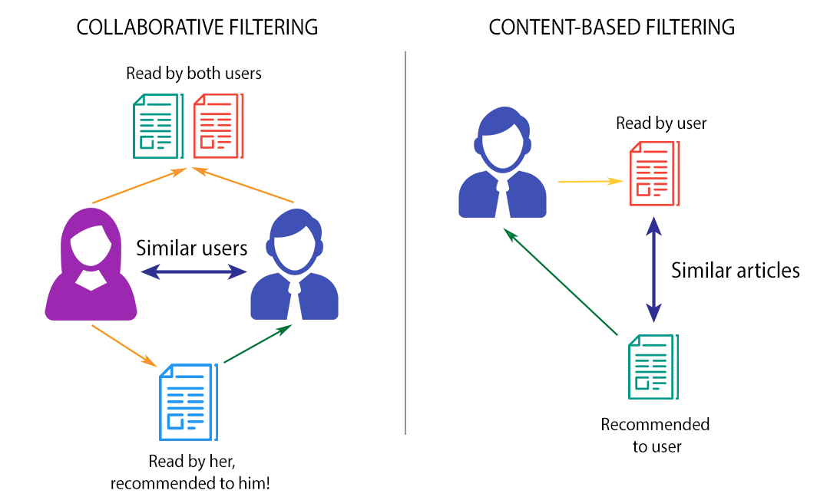
Mechanism of Recommender Systems
Content filtering: Recommend similar titles to users (Item-Item)
Collaborative filtering: Recommend similar titles based on user’s preferences and behaviour (User-User)
Notes:
Content filtering: recommend similar titles based on past titles they have interacted with. So for our case it will be recommending games to players based on past games they have played simply
Collaborative filtering: recommend similar game titles to similar users based on their behavior and preferences on various video games
and we will be building our models around these 2 mechanism

Slide 10
EDA

Slide 11

Notes:
In this work, we will be using the steam dataset sourced mainly from kaggle which consisting a list of game titles and users reviews about the various game

Slide 12
Dataset
Recommendations
Games
Metadata
Final dataset
10M
46K
~700k
46K
46000 unique game titles with game information till Feb 2023
10 million reviews from 5.8 million unique users Dec 2022
700k reviews from 40k unique users
46000 rows of unique description with game genre tags Feb 2023
Notes:
Datasets are recent, which means we dont have a benchmark score reference
Scale down from 10m -> 700k reviews due to computational limitations of machine

Slide 13
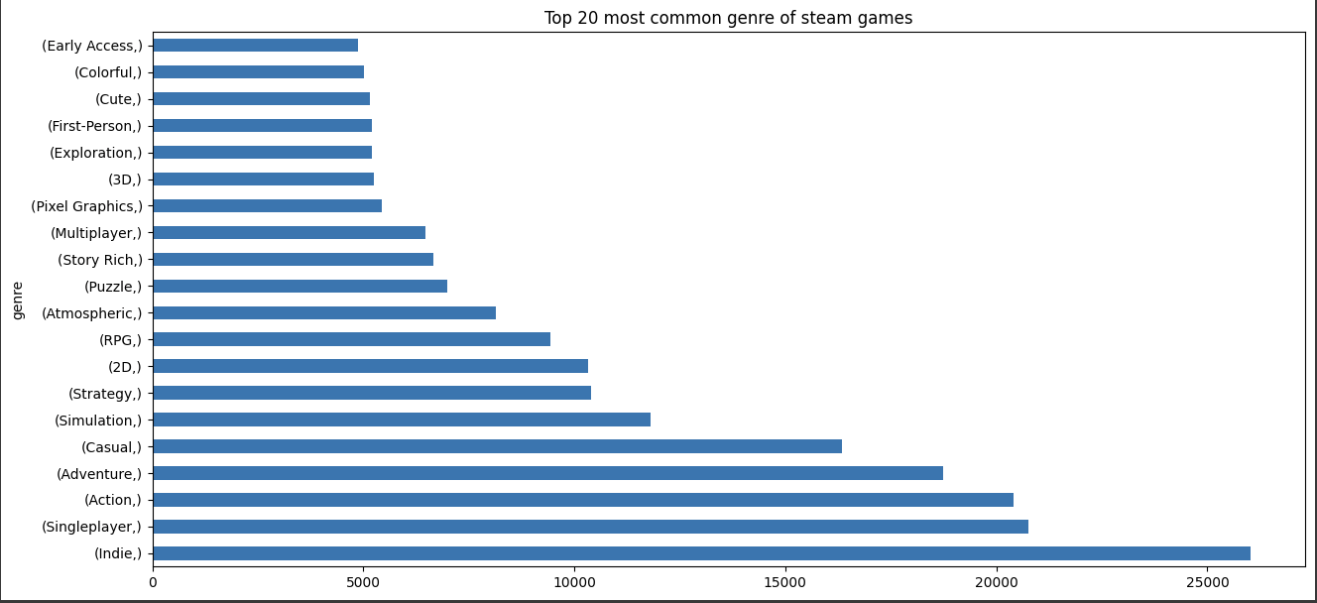
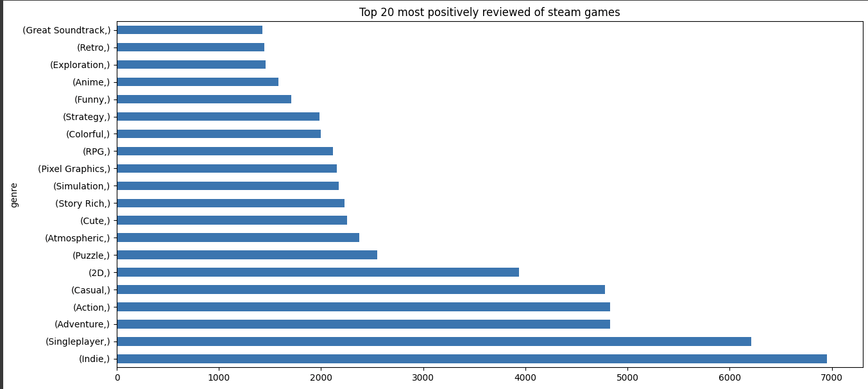
Action, Adventure, SinglePlayer, Indie and Casual genres most popular

Slide 14
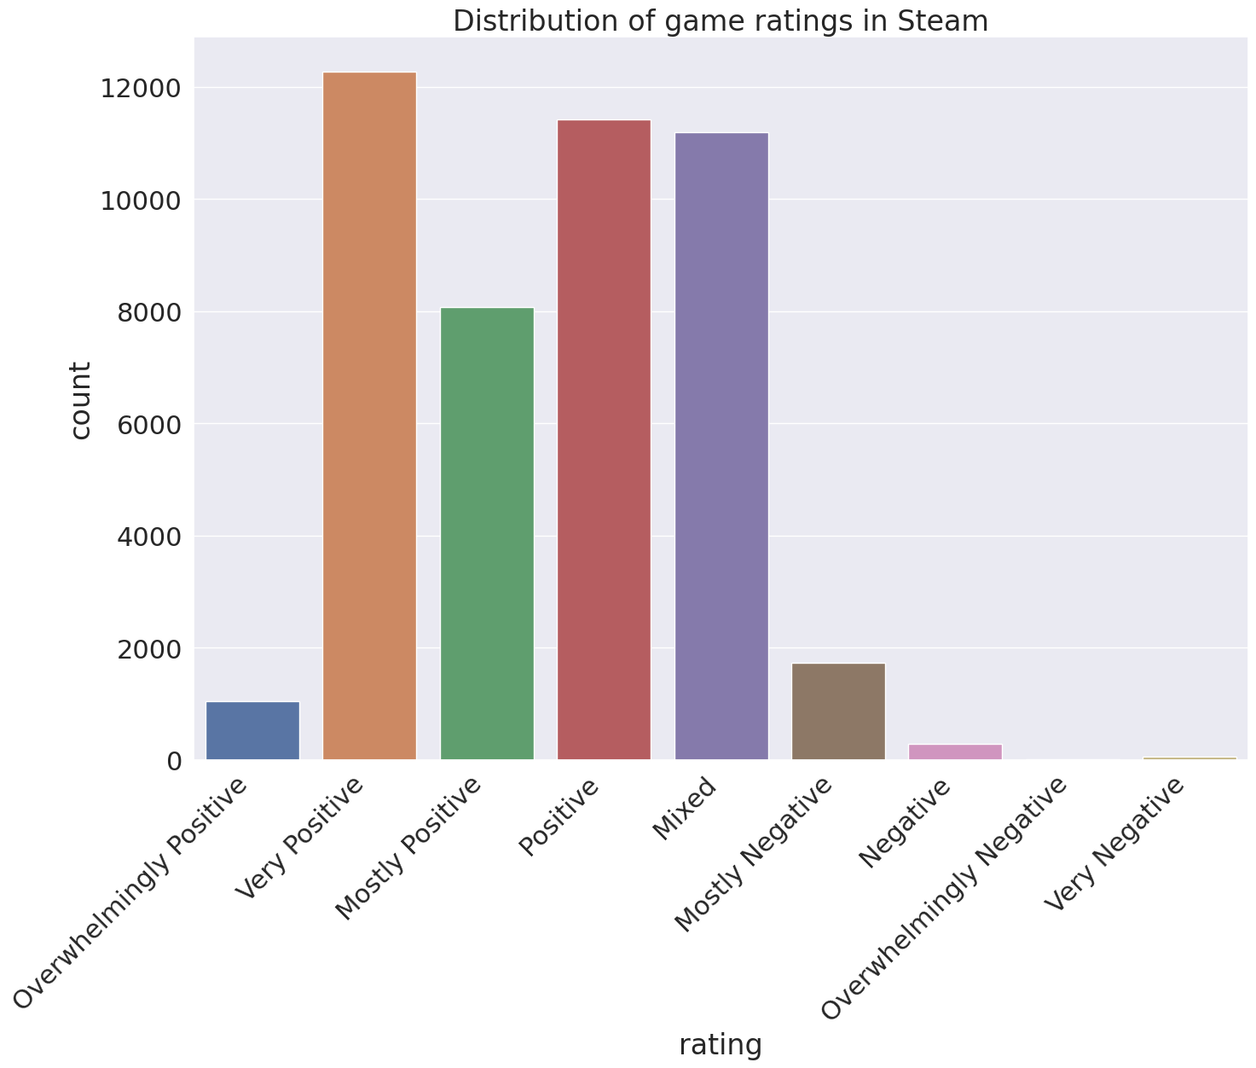
Most games are rated to be positive on overall

Slide 15
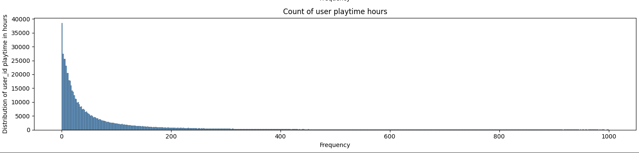
Most users have an overall average playtime of less than 100 hours
Notes:
Justifies our research findings from the study with a global average weekly playtime of approx 8-9 hours

Slide 16
Data Pre-processing

Slide 17
Content Filtering
Cosine Similarity
Merge games and metadata dataset
01
Count Vectorizer and TF-IDF Vectorizer
04
02
Games
Extract keywords from game description
Combine textual information
03
Using RAKE (Rapid Automatic Keyword Extraction) library in NLTK python
Large text of word corpus for NLP modelling
Notes:
Content filtering: Deploy NLP based model trained on textual information such as genre tags, game description, developer and publisher
Cosine similarity: Measures similarity score between past games and unplayed games -> recommend to user
mention that the streamlit demo will cover this

Slide 18


Collaborative Filtering
Binning transformation + rank scaling
Group the users’ playtime into 10 equal bins
Scale the bin groups into range of 1 to 5
Transformed feature will be directly inferred as scale of continuous ratings from users’ reviews
Playtime inference for explicit ratings
Steam does not provide platform for numerical ratings
Quantify relevance of each game title to individual users
If the user play a game for a long time: he/she likes the game
Notes:
Since Steam does not have a continuous rating feature, we will explicitly infer them based on the user’s playtime of the game, so as to quantify the relevance of each game title w.r.t individual users. And this is done on the assumption that if the user plays the game for a long time: they like the game and will be more likely to give a higher rating and recommend to other users

Slide 19
Modelling and Evaluation

Slide 20
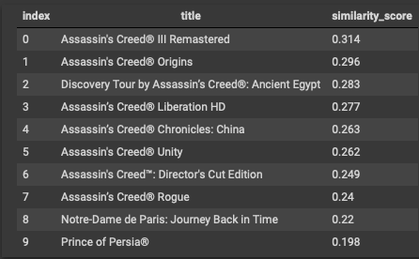
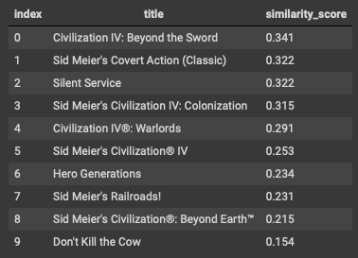
Content Filtering
Vectorizer: TF-IDF, ngram = (1,1)
Assassin's Creed® Odyssey
Sid Meier's Civilization® III Complete
Notes:
computes the frequency of each word appearing in the document and takes into account important words calculated through inverse document frequency, which gives more information regarding important words in each document within the entire corpus

Slide 21
Collaborative Filtering (RMSE)
1.5
1.4
SVD uses matrix factorization to decompose user-item matrix into individual user and item matrices
Identify latent features influencing interactions between users and products
1.3
1.2
1.1
1
0.9
1.443
0.984
0.981
1.009
1.119
Baseline
SVD
SVD++
SlopeOne
Co-Clustering
Notes:
SVD uses matrix factorization algo to decompose a large user-item matrix into matrices with smaller dimensions to reveal these ‘hidden’ features behind their interactions, so that we can tune them for our ratings predictions

Slide 22
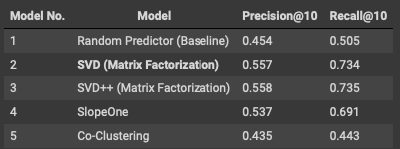

Collaborative Filtering (Precision@10, Recall@10)
Goal: provide comprehensive list of relevant game titles
Optimise Recall@10 meets the project requirements
Notes:
Precision@10 refers to the proportion of top 10 recommended items that are predicted correctly by the model to be relevant, Recall@10 refers to the proportion of top 10 relevant items that are predicted by the model to be relevant
recommended items -> estimated ratings of item by the model
relevant items -> true ratings of the items
Since our project aims to build a comprehensive list game titles from users to choose from a wide diversity of possible relevant games, it will be crucial to optimise our recall@10 score over precision@10, and our results have shown that the model is able to meet our requirements.

Slide 23
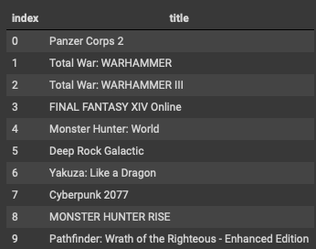
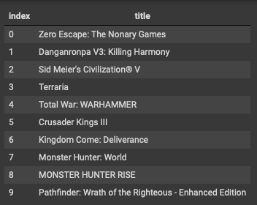
Collaborative Filtering
Model: SVD
Hyperparameters: n_factors = 20, n_epochs =10, lr_all = 0.005, reg_all=0.05
User ID: 4924848
User ID: 3869605
Notes:
here is a sample test run of the model’s performance in recommending new game titles, we can see that the model is able to successfully recommend new game titles to different users based on their ratings derived playtime activity

Slide 24
Selected Collaborative Model: SVD
Ability to scale for large datasets
Algorithm principle: Matrix Factorization
Identify latent features influencing interactions between users and products

Slide 25
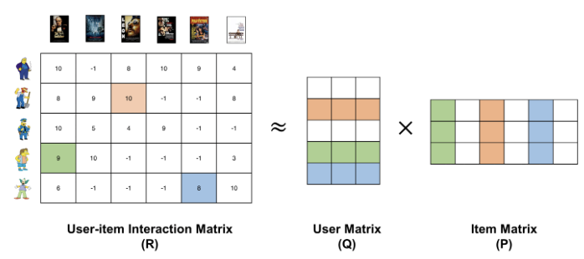
Matrix Factorization
Notes:
Breakdown a tabular of individual matrices of users, and items, and then combine them using matrix multiplication. The values in these individual matrices correspond to the user ratings
MF: matrix multiplication of tabular user matrix and item matrix -> rows: users, columns: product, values: continuous ratings

Slide 26
Conclusion, Limitations and Future Work

Slide 27
Conclusions
Goal 01.
Goal 02.
Built a prototype NLP Content Filtering model to accurately recommend game titles to users based on their past activity
Built a prototype Collaborative Filtering model to accurately recommend game titles based on users’ activity
Advantages
Disadvantages
Content Filtering: User-focused recommendations, Scalable to wide user pool individually
Collaborative Filtering: Takes into account user with similar interest and preferences to recommend titles to new users
Content Filtering: Cold Start, User specific centric
Collaborative Filtering: Sparsity, Scalability
Notes:
Content filtering benefits: able to cater across different users individually focus more personalised preferences and interests
collaborative filtering benefits: takes into account multiple users with similar interests and preferences and recommend new titles to these users
content filtering cons: cold start issue where its unable to recommend new users without first learning their preferences and interests in the beginning, only focused towards individual users
collaborative filtering: sparsity in user-item interactions can lead to inaccuracies in recommending new titles to users, high computational cost to maintain them as the dataset size increases which is something we faced in this project

Slide 28



Future Work
Deploy model on Cloud platform
Employ Implicit prediction algorithms
Employ hybrid based recommenders
Scaling up computing resources to address memory limitations on large datasets
More accurate predictions of users’ preferences from implicit features
Address cold start issue and matrix sparsity
Notes:
1.As we mentioned earlier, the original dataset has to be scaled down due to computational limitations on local machine. For future work, the analysis and model training should be deployed on cloud based platform to address memory limitation on the size of this dataset
2.Since our current work only involves prediction using explicit features such as ratings, we can look into ML algorithms that can directly predict users gaming preferences using implicit features.
3.Adress cold start issues for content filtering in new users, as well as matrix sparsity for users with little reviews in collaborative filtering

Slide 29
Thank You

Slide 30
Streamlit demo

